Slide 1
TABULAR DATA

Slide 2

Spreadsheets and databases rule the world!
There are many tools to handle tables: pandas, dask, spark, SQL databases, …
They all share the same basic concepts and operations
Here we’ll use Pandas for convenience
Ariel Fischman holds the Guinness World Record for owning the most spreadsheet software (over 500!)
https://techcommunity.microsoft.com/t5/excel-blog/guinness-world-records-the-largest-collection-of-spreadsheet/ba-p/216592

Slide 3
What is tabular data?
What is it? columns have different types, rows can have a meaningful index
Date (index) | Wind speed | Wind direction | Rain fall (mm) | Hours of sun
7.3.2024 | 7.1 | N | 0.0 | 10
8.3.2024 | 0.3 | NW | 2.1 | 2
9.3.2024 | 1.1 | SE | 0.3 | 5
Subject ID (index) | Condition ID | Presentation nr | Response time (ms) | Response
VM | 732 | 2 | 28 | LEFT
VM | 732 | 3 | 41 | RIGHT
PB | 665 | 1 | 73 | LEFT

Slide 4
Storing and using tabular data
Python tools
pandas: columnar, in-memory
dask: columnar, on-disk
SQL databases
optimized for retrieving rows (tree data structure for index)
transactional: groups of operations are either all executed, or none
Columnar DBs, Spark, Hadoop
optimized for operations on columns
ideal for data science tasks
operations can be automatically distributed over multiple machines

Slide 5

Introduction to Pandas
Live Coding
notebooks/tabular_data/ 010_pandas_introduction.ipynb
Main points:
A DataFrame is a tabular data structure
DataFrames have labeled columns and rows (“indices”)
Columns can be of different native dtypes
Operations are on columns by default
NaNs are interpreted as missing data and ignored in most operations
Strings (and dates) have a special accessor to perform vectorized string (or date) operations

Slide 6
NEED REFERENCE SLIDE
Summary of basic Pandas operations

Slide 7

Tabular data example from the lab
Research question: Can homeostatic plasticity be induced in human pyramidal neurons from acute brain slices?
Exp design: patch clamp recordings from the same cells (or different cells/ same slices) before and after prolonged incubation in high K – elevated activity condition

Slide 8
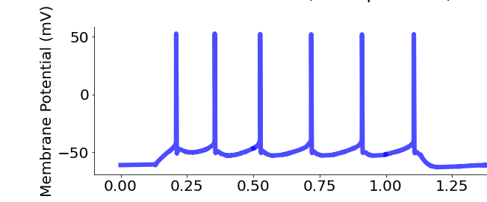
Variables
Applied Current
300 pA
D1

Slide 9
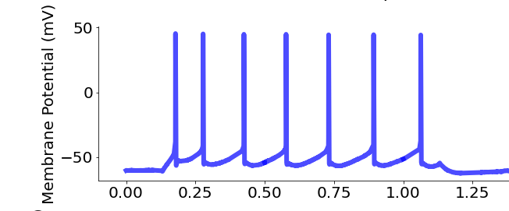
Variables
Applied Current
300 pA
D1
D2

Slide 10
Variables
D1
resting_potential = -74.3 mV
* *. *. * * *
max_spikes = 6
D2

Slide 11
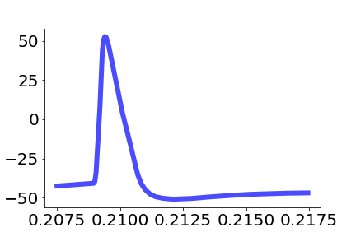
Variables
D1
mV
D2
Time (seconds)

Slide 12
Variables
Action potential (AP) properties
D1
resting_potential = -74.3 mV
* *. *. * * *
max_spikes = 6
max_repol =
-91.4 mV/ms
AP_heigth
= 92.2 mV
mV
AP_halfwidth
= 0.91 ms
D2
max_depol =
377.4 mV/ms
TH =
-39 mV
Time (seconds)
Time (seconds)

Slide 13

Hands-on Have a look at the electrophysiology data
Exercise
exercises/pandas_intro
Submit a PR for Issue #? on GitHub

Slide 14
Common operations on tabular data
Tabular data has additional needs compared to arrays. Understanding how to vectorize these operations is critical for handling them
Combine information across tables (join, anti-join)
Join: e.g., combine table with experiments results with table with experiments metadata (date, location, experimenter, free-form notes, …)
Anti-join: e.g. student compiles list of outliers, exclude them from the table of experiments to analyze
Summary tables (split-apply-combine):
E.g., compute average measurement and standard deviation by experimental condition and treatment dosage
Window functions

Slide 15
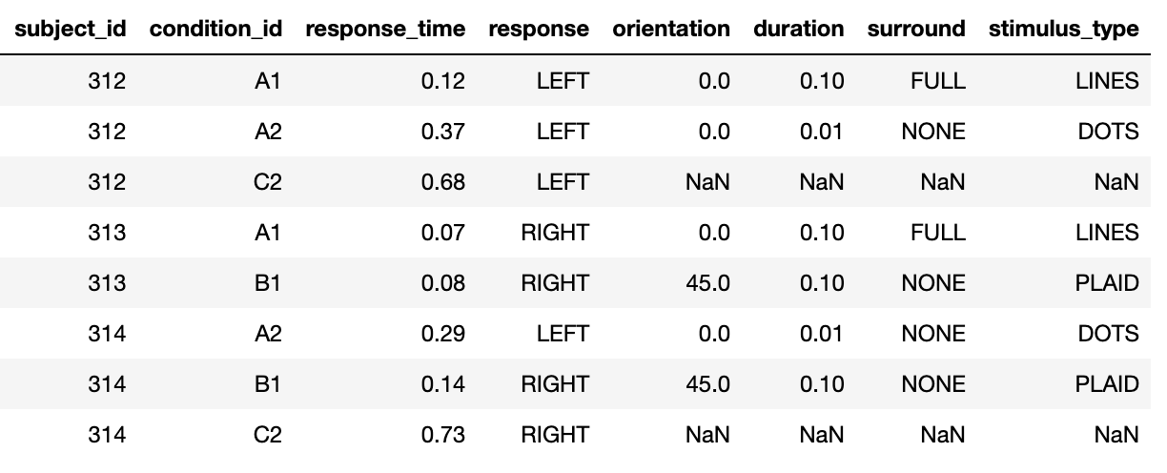
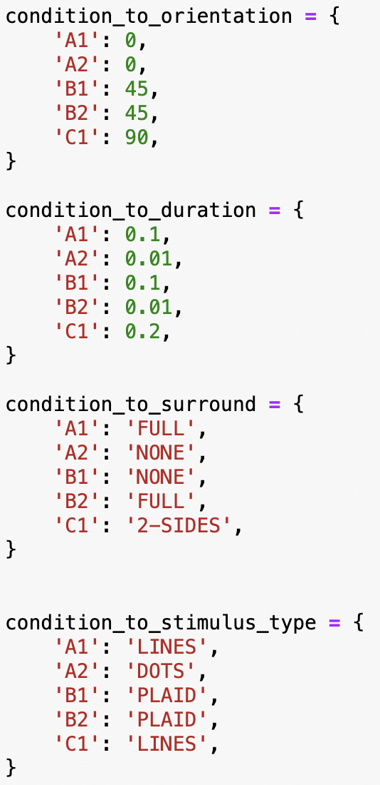
Join operations: combining informations on separate tables
+
=

Slide 16
Join operations
Live Coding
notebooks/tabular_data/
020_join_operations.ipynb
Main points:
Join operations can be used to combine two tables using the values of one or more columns
Different types of join:
left/right: keep all the column values that are present in the first/second table
inner: keep all the column values that are present in both tables
outer: keep all the column values that are present in one or the other tables
Anti-joins can be used to exclude the values that are present in one, but not the other table (filtering based on arbitrary criteria)

Slide 17
Hands-on
Exercise
?
Merge data from electrophysiology experiment with metadata, by experiment ID and area(?)
Exclude list of outliers
Submit a PR for Issue #? on GitHub
TODO

Slide 18
split-apply-combine: the basic structure of most numerical analyses
split by condition
compute avg response time
combine result
note that the “apply” can be parallelized

Slide 19
Grouping
NOTEBOOK: compute mean by …
show for-loop solution -> horror
group-by + operation
exercise
then pivot-table

Slide 20
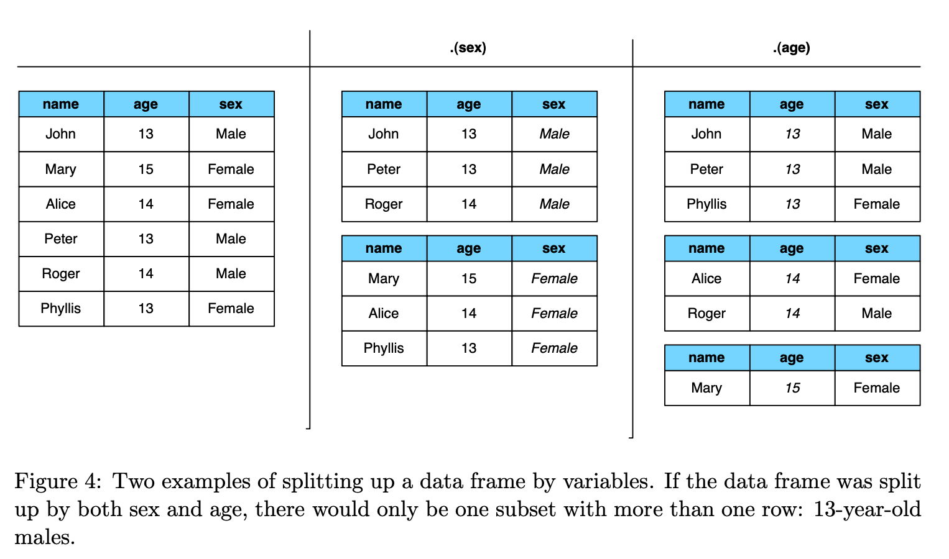
groupby, pivot_table
students
.groupby(‘age’)
[‘name’].nunique()
age | count
13 | 3
14 | 2
15 | 2

Slide 21
Data organization
Do this part after showing all the pivots, melt etc.
do all exercises before with tidy data, then do the last exercise with untidy data -> why was this one so difficult??
Data organization concepts:
tidy data
normalized data (star organization)
data science friendly data (denormalized)

Slide 22
Tidy data
“Tidy datasets are all alike but every messy dataset is messy in its own way” – Hadley Wickham
Let’s talk about data organization: what does “clean” data look like?
We want data to be in a natural format, where data analysis is easy
Let’s look at what tidy data looks like, then why it’s better that way
Values are organized in variables and observations
Observations increase when new units (dates, subjects, …) are measured
Variables (or features, attributes)
increase when new types of measurements are introduced
Subject ID (index) | Condition ID | Presentation nr | Response time (ms) | Response
VM | 732 | 2 | 28 | LEFT
VM | 732 | 3 | 41 | RIGHT
PB | 665 | 1 | 73 | LEFT
Observations (or samples)

Slide 23
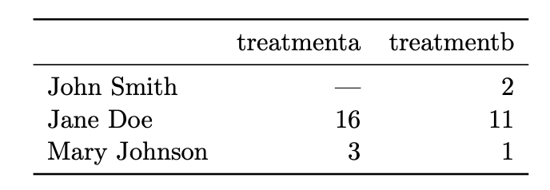
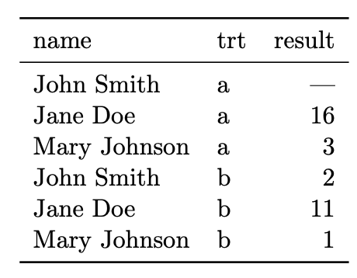
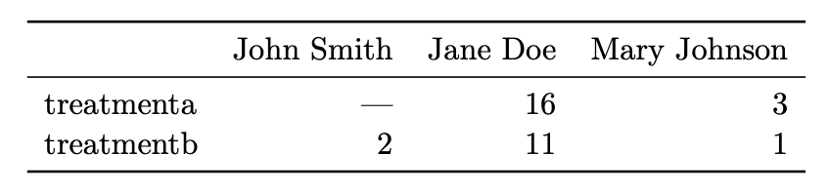
Same data, different organizations -- which one is best for data analysis?
imagine adding a new measurements, e.g. accuracy
The value of the treatment variable is in the column/row name. Imagine wanting to compute the mean over treatment type

Slide 24
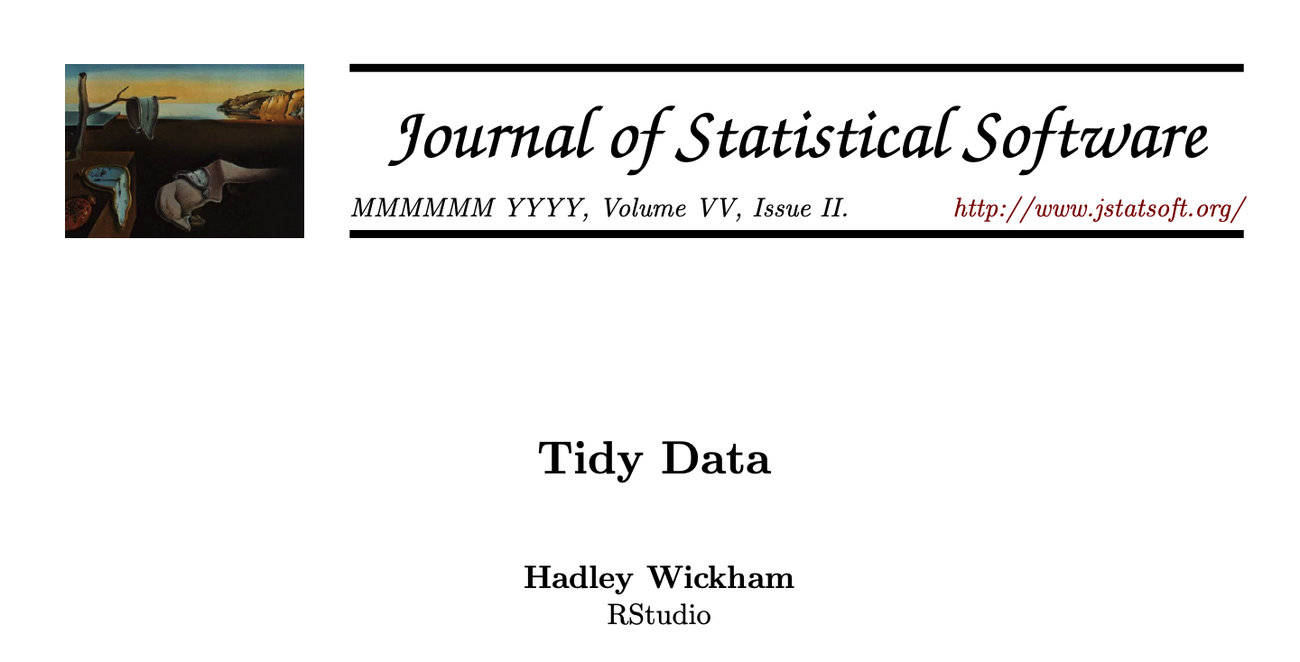
Tidy data
In a given analysis, there may be multiple levels of observation. For example, in a trial of new allergy medication we might have three observational types: demographic data collected from each person (age, sex, race), medical data collected from each person on each day (number of sneezes, redness of eyes), and meterological data collected on each day (temperature, pollen count).
In tidy data:
1. Each variable forms a column. 2. Each observation forms a row. 3. Each type of observational unit forms a table

Slide 25
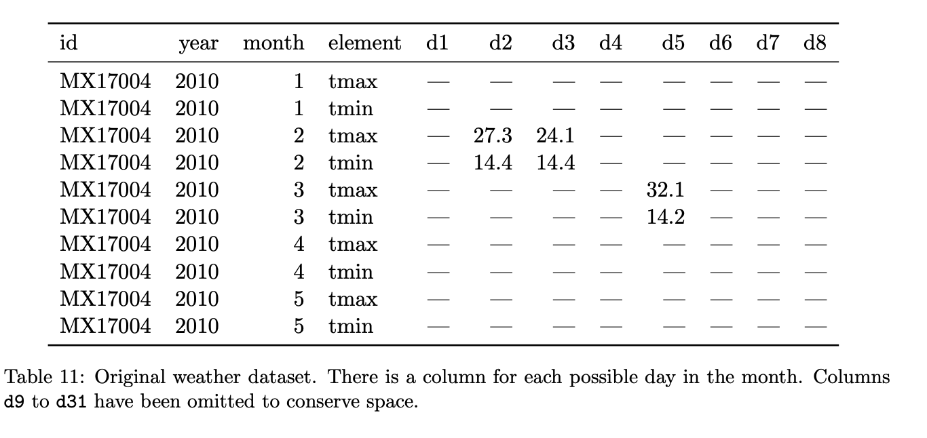
Hands-on: identify variables, observations, and values. What would a tidy version look like?
notice the structural NaNs for months with less than 31 days

Slide 26
Messy data
Column headers are values, not variable names -> as in the example above
Multiple variables are stored in one column.
Variables are stored in both rows and columns.
Multiple types of observational units are stored in the same table.
A single observational unit is stored in multiple tables
Sometimes data is split in files, and the file name is a variable! e.g. 2024-01_prices_DE.csv, 2024-01_prices_FR.csv, 2024-02_prices_DE.csv, 2024-02_prices_FR.csv, …

Slide 27
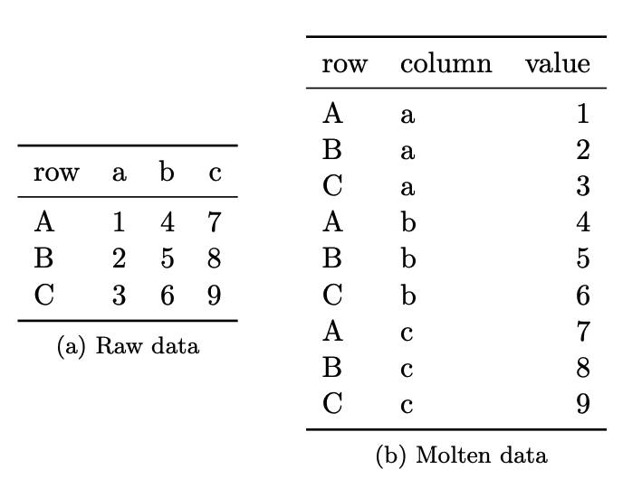
Make data tidy!
stack, unstack, melt

Slide 28
Hands-on: tidy up the data set in the previous exercise, and re-compute the summary stats
Billboard 100, max position per artist and month?
TB dataset: compute TB rate for gender between 2000 and 2006, compare with 2007-2012

Slide 29
Why is tidy data good?
One can write generic code that takes tidy data as input. For example, pd.pivot_table
Joining tidy tables is easy!
Most analyses require a simple sequence of steps:
Filter by individual variables to discard data that is not needed
Group and summarize
Re-arrange (e.g. sort)
Visualize
E.g. seaborn combine the last 3 steps to perform easy visualization with tidy data set (example?)

Slide 30
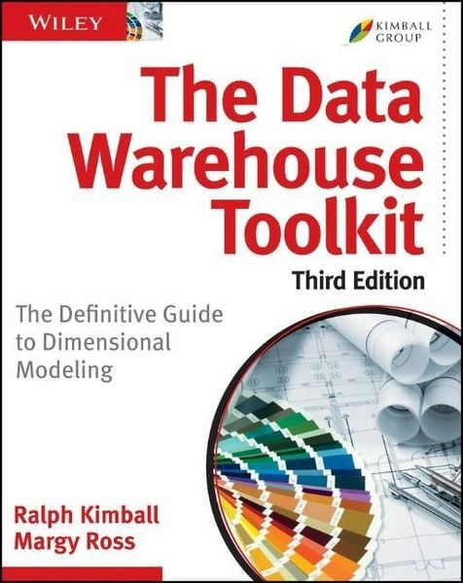
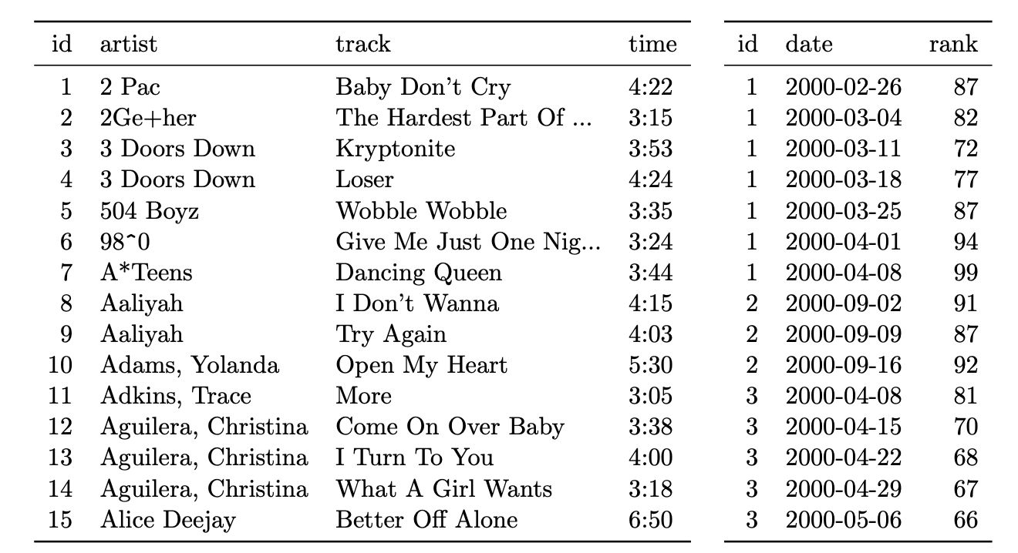
Organizing multiple tables
Dimension vs fact tables
De-normalization (but for data analys flat tables are more convienent)

Slide 31
Advanced: window functions

Slide 32
Dealing with changes in the data
Recommendations:
NEVER overwite a data file. Treat data files as immutable
Use versioning for changes in the data file, and load the latest version for new analyses, old versions to reproduce previous results
(pond is a library I’m working on to automatize this process)
Like in computer code:
Adding new columns / rows is generally ok
Deleting/changing a column is not! Code will break! Add a new column instead

Slide 33
Summary
high-level concepts that we learned

Slide 34
What we didn’t talk about
Other data structures: graphs, trees, priority queues, …
Options for working with large data on disk / remotely (instead of in-memory)
Advanced tabular data operations: window functions
Best practices in data handling: versioning, lineage, sharing

Slide 35
Thank you!

